Slide 1

WNE UW
Monte Carlo Simulation and Bootstrap
From Moodle folder, download and unzip and run:
The R project Topic_3_2_MC.Rproj [is an old project where you only find R scripts.
The MC and Bootstrap.Rproj [ it is a new project; open and run test MC.Rmd. You will obtain the report with explanations mainly based on my slides and Chat GPT „licentia poetica.” I have to check and correct the poet. I mostly migrated scripts from an old project.
Notes:
1

Slide 2
Monte Carlo simulation
In economics, we use MC simulation to:
- solving mathematical problems
- testing the stability of our models
- examining the influence of uncertainty on results our decisions

Slide 3
Monte Carlo simulation
There ara two ways to test theoretical/empirical models: use Monte Carlo simulations or bootstrapping. Thanks to these methods, we obtain a better picture of reality than just one equilibrium point from the theoretical model.
Monte Carlo Simulations
Generate multiple random scenarios to understand the range of possible outcomes.
Offers a comprehensive view beyond a single theoretical outcome.
Bootstrapping
Utilize resampling to estimate the precision of sample statistics.
Provides insight into the variability of the model's predictions.

Slide 4
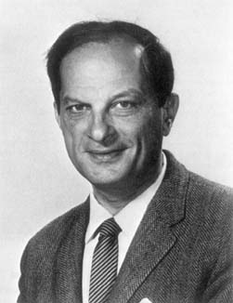
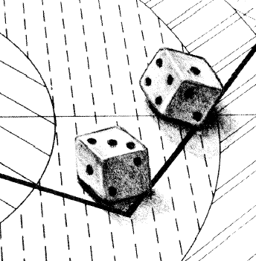
Monte Carlo simulation
What is the Monte Carlo simulation? The definition is complicated because it depends where we use it. But simple definition by Stanislaw Ulam is enough for us.
… solving mathematical problems using statistical sampling.
Stanislaw Ulam
(1909-1984)
My not formal approach: nature plays dice with us - we can play dice to solve the problem that nature has given us by mimicking the randomness of nature.

Slide 5
MC Solving mathematical problems
Suppose a mathematical problem is too complicated and we are unable to provide an analytical solution. Sometimes, there is no such solution, or we are unable to obtain it. Well, from a certain level everyone is ignorant but ... we can always find a numerical solution.
From Moodle folder, dowload and unzip and run the R projects

Slide 6

How to find π - play dart
Understanding π: Beyond Constants
π is the ratio of the circumference of a circle to its diameter.
What if π is unknown to us?
Is there an analytical method to derive π?
r = 1
The Dartboard Experiment: Estimating π
Let's play dart (close your eyes) blindfolded throws at a dartboard.
Count the hits within the square boundary and the hits within the quarter-circle.
Estimate π by calculating the ratio of the two counts

Slide 7
How to find π
Solution: play dart in R [ script: pi_MC.R]
# generating artificial throws to the dartboard
N <- 10000 # Number of throws
x <- runif (N, 0,1) # random [uniform] x coordinates
y <- runif (N, 0,1) # random [uniform] y coordinates
dist <- sqrt (x ^ 2 + y ^ 2) # circle equation
inside <- ifelse (dist <= 1, 1,0) # points inside the circle
prob_inside <- sum(inside)/N # percentage of points inside
pi <- prob_inside * 4 # determination of the PI number
# drawing of points inside the dartboard
plot (x [dist <= 1], y [dist <= 1], xlab = "x", ylab = "y", main = paste ("Monte Carlo simulation N =", N), col = "red" )
points (x [dist> 1], y [dist> 1], col = "gray")
text (0.8,0.9, paste ("Pi approximation =", pi), col = "red")
r = 1
(¼ circle area) / (square area) = (¼ π r²) / r²
π = 4*(numbers of hits of the quarter of dartboard) / (numbers of hits on the square)

Slide 8
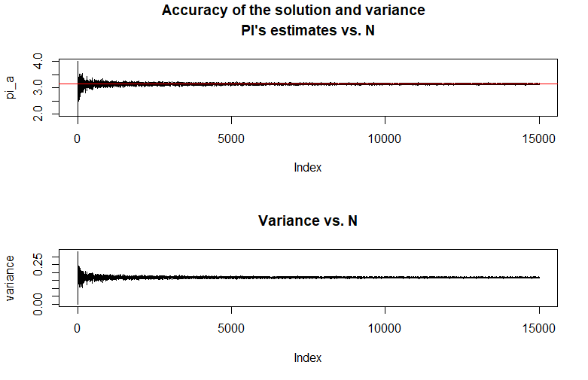
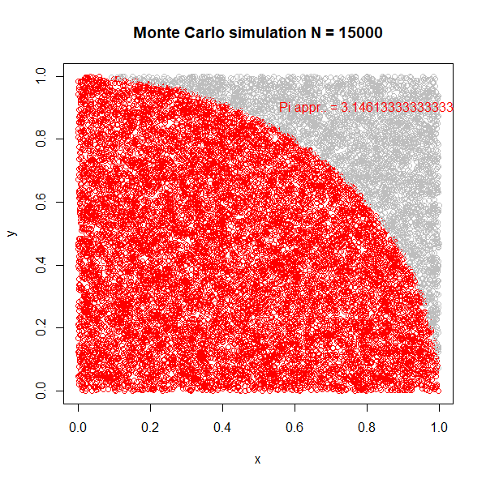
MC simulation
The optimal choice of N in simulations:
Tradeoff: precision and computational cost. Modern computers handle larger N without problems, but efficiency still matters (my most extensive simulation, parallel computation, eight cores and 5 days of work).
Sometimes, efficient algorithms are necessary despite advanced computing power.
Testing for convergence to ensure the reliability of the simulation results.
Selecting the appropriate random distribution (uniform, normal, beta...) for simulation
The importance of choosing a random distribution which is suitable for the specific problem.
The same method can be used to calculate the area determined by function on a given interval - calculate the definite integral.

Slide 9
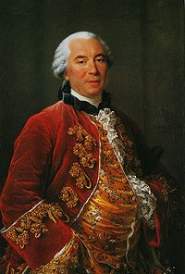

Prehistory of MC ☺
The social game "Buffon needle"
Drop N-times needle with length L on a plane with two lines. The distance between the lines is D
Georges-Louis Leclerc,
Comte de Buffon
(1707 - 1788)
Additional inspiration – explore if you feel like it!
D
L
Experiment: Based on the number of intersections of the needle with the lines, we conclude about ... π. For mathematical background go to http://www.mste.uiuc.edu/reese/buffon/buffon.html Now we can enjoy an animation in R

Slide 10
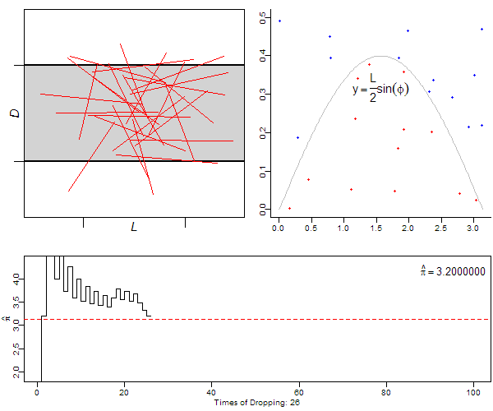
Prehistory of MC ☺
The old scientific demonstration "Buffon needle"
For the length L equal or less than the distance D the probability of line intersection is p = (2 * L) / (π * D)
We throw the needle N times and sum number of crossings of the needle with lines ( K )
Simulated probability: P_s = K / N
then
π = 2 * (L * N) / (K * D)
Buffon_needle.R
Additional inspiration – explore if you feel like it!
https://yihui.org/animation/examples/

Slide 11
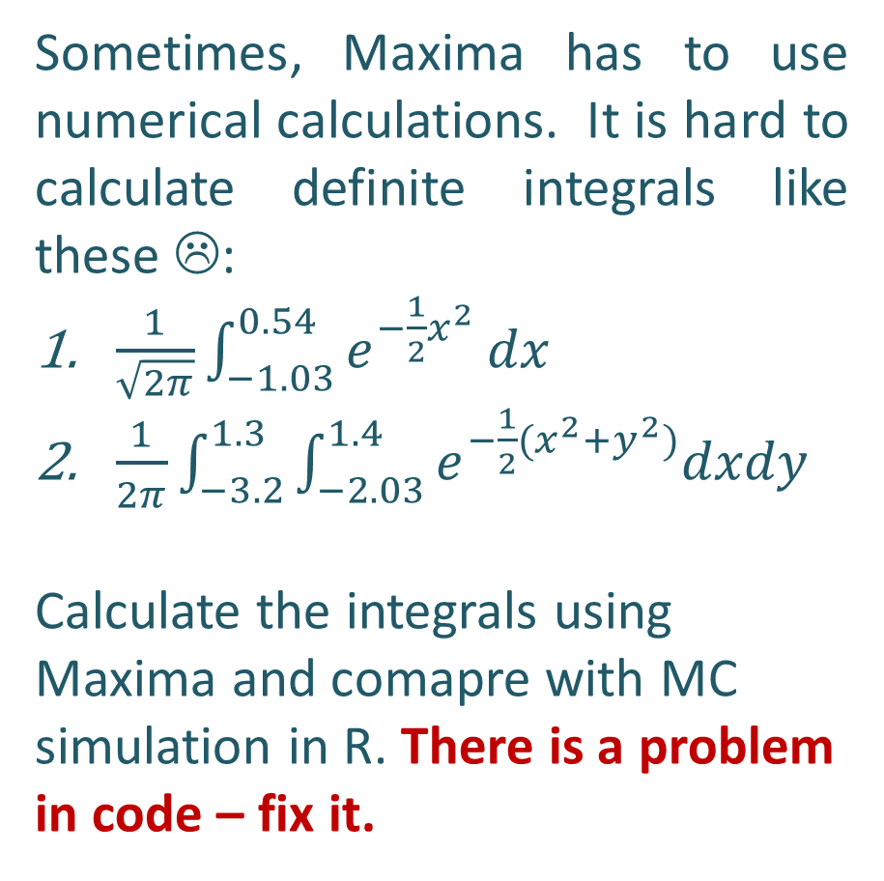
Task MC simulation (at home - R)
Additional inspiration – explore if you feel like it!
Sometimes, Maxima has to use numerical calculations. It is hard to calculate definite integrals like these ☹:
$\frac{1}{\sqrt{2π}}\int_{−1.03}^{0.54}{e^{−\frac{1}{2}x^{2}}}dx$
$\frac{1}{2π}\int_{−3.2}^{1.3}{\int_{−2.03}^{1.4}{e^{−\frac{1}{2}{(x}^{2}+y^{2})}dxdy}}$
Calculate the integrals using Maxima and comapre with MC simulation in R. There is a problem in code – fix it.
Use functions mcint from integrals_MC.R
Modyfy only these part of codes:
funkcja3 <- function(x) {(1/8)*x^3-(1/8)*x^2-1*x+2} # change
integral_1 <- mcint( funkcja3,-1,5,100000 ) # change
integral_1
Funkcja4 <-function(x,y) {(1/8)*x^3-(1/8)*x^2-x+2+(1/8)*y^3-(1/8)*y^2-1*y} # change
a<-c(-2,3)
b<-c(-2,3)
integral_2 <- mcint2(funkcja4,a,b,10000)
integral_2
In Maxima modyfy the bolded parts.
kill(all)$
integrate (x^2*exp(-x^2), x, 0.3, 0.8)$
float(%);
kill(all)$
integrate(integrate( x*y^2 * exp(-x*y^2), x, 0.4, 0.9),y,0.5,0.7)$
float(%);

Slide 12
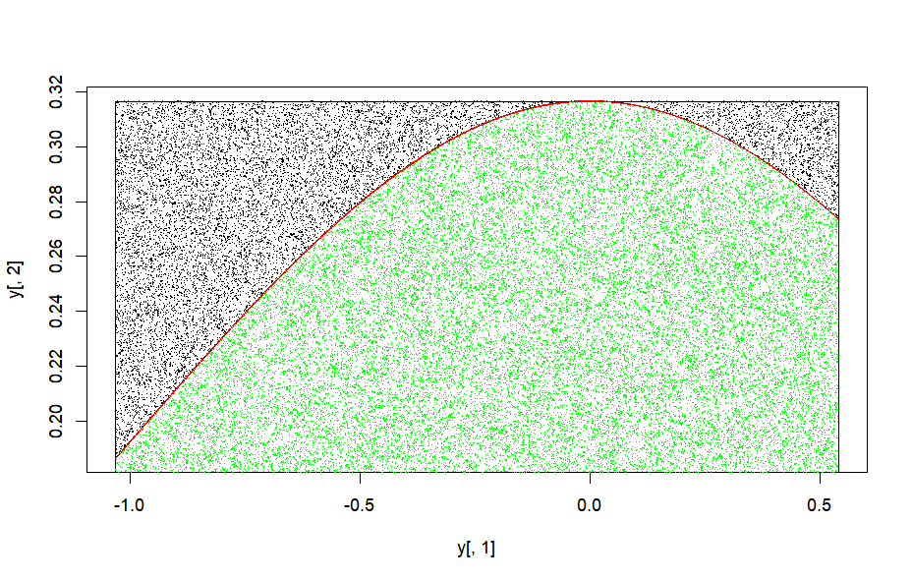
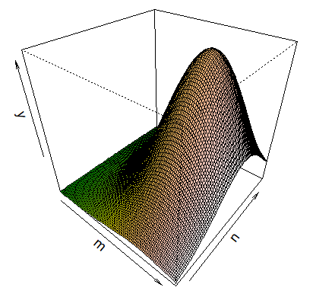
Task MC simulation (at home - R)
Use functions mcint from integrals_MC.R
funkcja4<-function(x,y) {(1/((2*pi)) ) * exp(-1/2*(x^2 + y^2)) }
a<-c(-3.2,1.3)
b<-c(-2.3,1.4)
integral_2 <- mcint2(funkcja4,a,b,10000)
> funkcja3<-function(x) {(1/((2*pi)^1/2) ) * exp(-1/2*x^2) }
> integral_1 <- mcint(funkcja3,-1.03,0.54,100000)
[1] 0.4401905
Additional inspiration – explore if you feel like it!

Slide 13
Optimization
Additional inspiration – explore if you feel like it!
The same method as calculateing integrals can be used to find the optimum of a function. We draw numbers from a uniform distribution in a given range [a,b] and calculate values of the function for the drew numbers and search for the maximum or minimum value. ( See the Optimize vs MC.R script). It is especially useful when the problem of the local optimums occurs. Sometimes optimization procedures stop in the local optimum, not the global one.

Slide 14
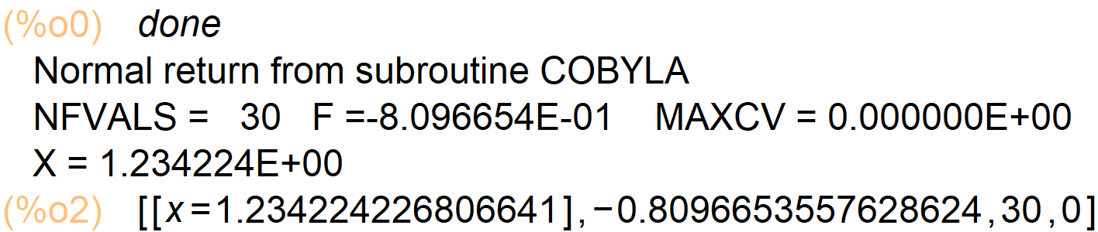

Optimization
Lets compare: Maxima, R inbuilt function optimize and MC simulation to find the minimum of the fuction : $\frac{sin⁡(18 xlog(x)}{x}$ on interwal [1,2]
The result of the optimization packeges procedure in Maxima (fmin_cobyla).
The result of the optimize inbuilt procedure in R (Optimize vs MC.R )
kill(all);
load("fmin_cobyla")$ /* loading the optimization package */
fmin_cobyla(sin(18*x*log(x))/x, [x], [1.5], constraints = [x>=1, x<=2],iprint=1);
[1] "Code execution time 0.2069"
$minimum
[1] 1.736813
$objective
[1] -0.5756502
Additional inspiration – explore if you feel like it!
We have conflicting results, which is correct?

Slide 15
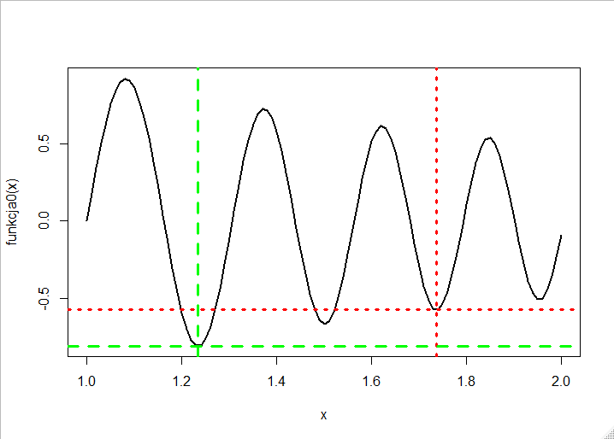
Optimization
For the R function optimize, the optimization procedure stops on a local minimum (red lines). MC simulation is robust (green lines).
[1] "Code execution time 0.2069"
$minimum
[1] 1.736813
$objective
[1] -0.5756502
The result of the optimization inbuilt procedure in R (optimize)
The result of the MC simulation, number of iteration
N = 10000 ( see Optimize vs MC.R )
The result of the optimization packeges procedure in Maxima (fmin_cobyla).
Additional inspiration – explore if you feel like it!
[1] "Code execution time 0.03490"
> print( paste("y min = ",y[i], "for x = ",x[i]), )
[1] "y min = -0.809664421506188 for x = 1.23429484688677"
MC is straightforward, but the results of this method comparison show how a powerful tool it is.
The Maxima result we can treat as a benchmark.

Slide 16
More practical example: risk estimation of business (will be continued)
You are going to sell your product by internet auctions.
-> The starting price is equal to the cost of the product C = 90.
-> You expect that the minimum number of sold units is 100, the maximum 1000 and the most "probable" is to sell 350 units per month.
-> You expect that the maximum transaction price is 30 PLN greater than starting price and any transaction prices from the interval [90,120] are equally probable.
-> You know the market characteristic --> 9% of transactions generate losses. The loss is equal the cost of the item plus the cost of delivery L = 110 (loss of parcel)
-> Fix cost of your business is 7 000 monthly
Perform a Monte Carlo simulation (100,000 iterations) of profit for one month. Are you really going to run the business?

Slide 17
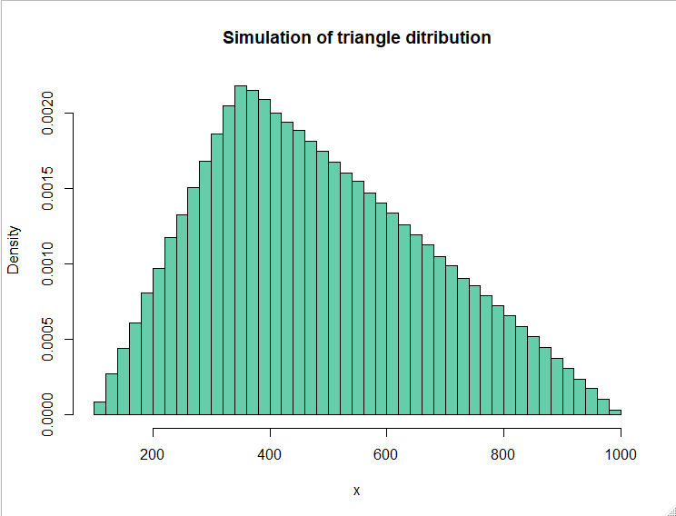
More practical example: risk estimation of business (will be continued)
You expect that the minimum number of sold units is 100, the maximum 1000 and the most "probable" is to sell 350 units per month --> the distribution of sold units X can be approximated by a triangular distribution
a: the minimum value 100,
c: the peak value (the height of the triangle) 350
b: the maximum value of 1000.
x ~triangle[100,1000,350]

Slide 18
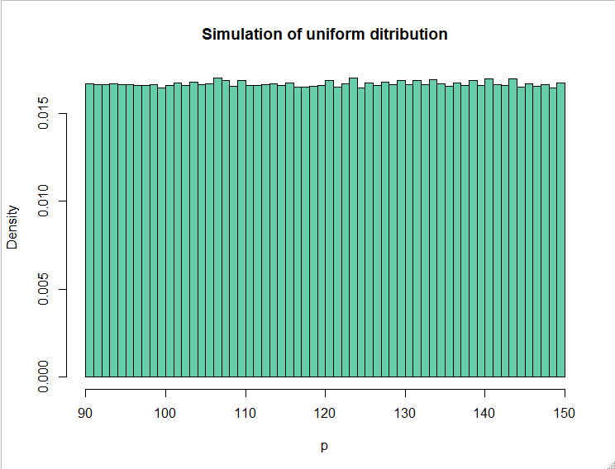
More practical example: risk estimation of business (will be continued)
You expect that the maximum transaction price is 30 PLN greater than starting price and any transaction prices from the interval [90,120] are equally probable. --> the distribution of transaction prices can be approximated by a uniform distribution
p~unif[90,120]
  c: the lower limit = 90
  d: the upper limit = 120

Slide 19
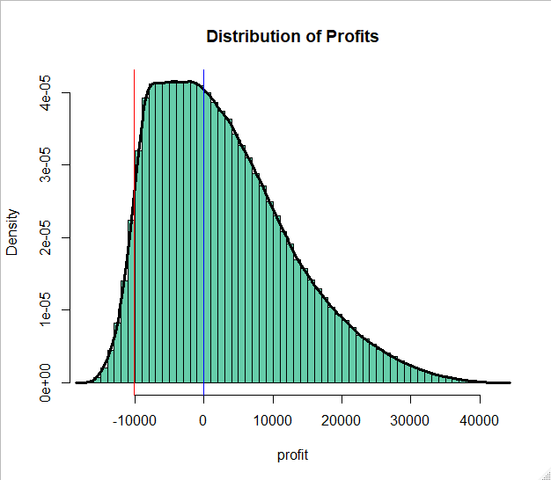
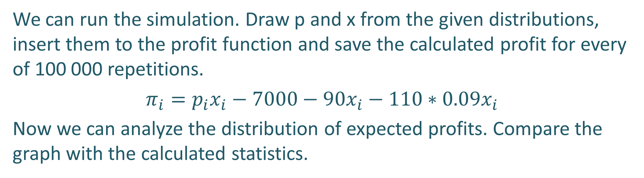
More practical example: risk estimation of business (will be continued)
We can run the simulation. Draw p and x from the given distributions, insert them to the profit function and save the calculated profit for every of 100 000 repetitions.
$π_{i}=p_{i}x_{i}−7000−90x_{i}−110∗0.09x_{i}$
Now we can analyze the distribution of expected profits. Compare the graph with the calculated statistics.
What do you think about the new business?
Min. 1st Qu. Median Mean 3rd Qu. Max.
-16679 -4926 1191 2726 8656 42209
In the file Profit_MC_1 you can find the MC codes.

Slide 20
More practical example: risk estimation of business (will be continued)
VaR (Value at Risk) determines the value of the loss of assets/liabilities with the adopted tolerance level (usually 5%), in given market conditions, over a specified period of time. The idea: ignoring the 5% least probable results, how much can we lose maximally in a given time horizon (what is the worst scenario) This is a different definition of risk based on position measure - usually it is the fifth percentile of the distribution of a random variable (cash payoffs, returns, ... )
What do you think about the new business?
In the file Profit_MC_1 you can find the MC codes.

Slide 21
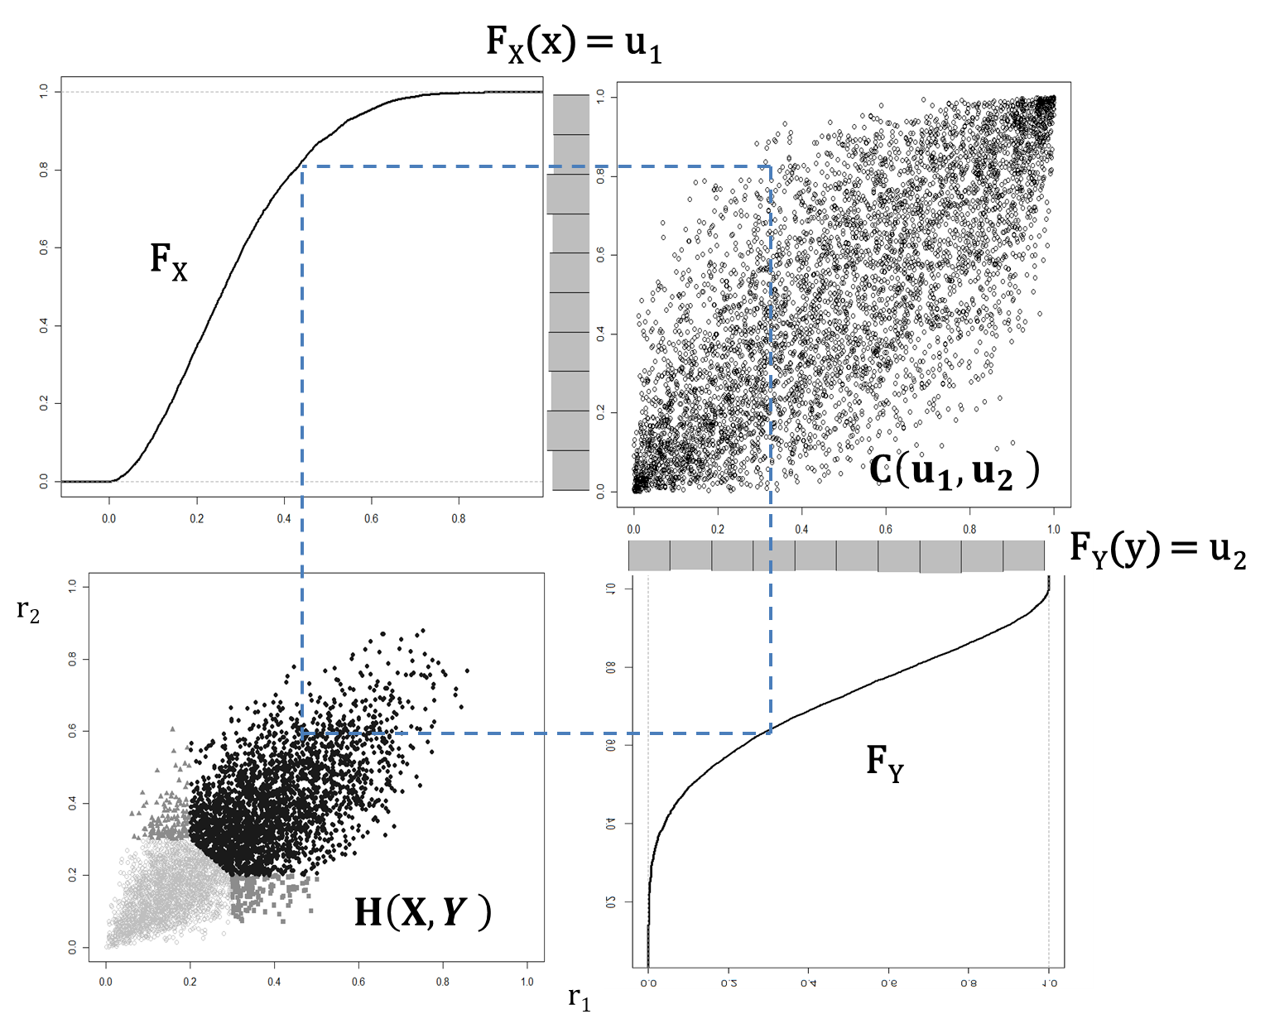
How to simulate dependencies?
If you want to generate variables that are dependent you can use the copula function. Copula C can be interpreted as a structure of dependency between random variables, which does not depend on the marginal distributions of these variables. The copula function can be used to obtain the N-dimensional distribution for i) given marginal distributions ii) different dependency forms (See examples Copula.R)
X, Y - random variables
H (x, y) = P [X ≤ x, Y ≤ y] - total cumulative distribution function
F(x) = P [X ≤ x] = H [x, ∞] - marginal cumulative function for X
G(y) = P [Y ≤ y] = H [∞, y] - marginal cumulative function for Y
By Sklar's theorem (Nelsen, 2006) : The copula will be a function combining F and G into two-dimensional joint distribution H.
H (X, Y) = C (F (x), G (y))
https://datascienceplus.com/modelling-dependence-with-copulas/

Slide 22
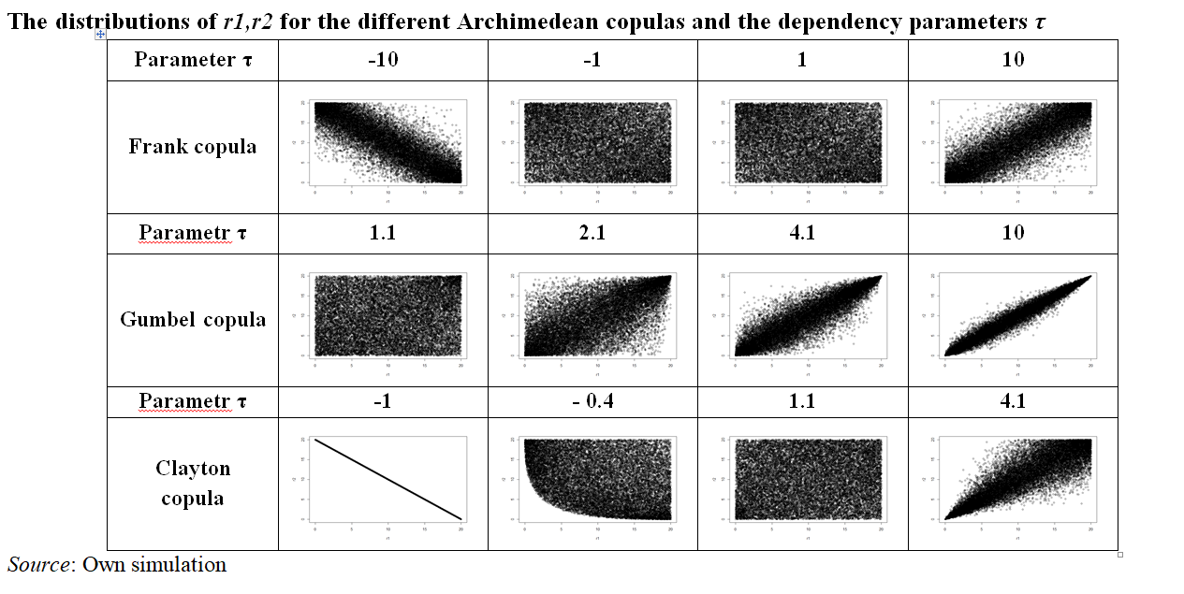
How to simulate dependencies?
Treat the copula as Lego bricks construction. The copula is N-dimensional connector and you can attach any marginal distribution and you can create (estimate) any kind of join N-dimensional distribution. Even more, the is a lot of copulas which model non-linear properties of dependence between variables. In Gumbel copula, the dependence is stronger for large values of X and Y. In Clayton copula, the dependence is stronger for small values of X and Y [a very important property in finance] . You can pivot the dependence [ Gumbel90, Gumbel 180], …. https://www.frontiersin.org/articles/10.3389/fams.2021.642210/full

Slide 23
More practical example: risk estimation of business (continuations)
The simplest to use is the Gaussian (normal) copula. It „glues” two or more marginal distributions and the dependence between the variables is defined by simple linear correlation (correlation matrix). In our MC simulation of the profits we can make a new assumption: The sold units X is correlated with the transaction prices. Before running the simulation, answer the question: What is more profitable for a new business: positive correlation, negative correlation or no correlation?
  A: Positive correlation is beneficial (A sort of Veblen good, price is the only one indicator of the quality and the higher is the price the higher is the demand - we would like to buy a good quality item. )
  B: Negative correlation is beneficial (A typical demand function but the relationship is stochastic)
  C: No correlation is beneficial (there is no relationship – the demand is random)
  D: Correlation does not affect profitability

Slide 24
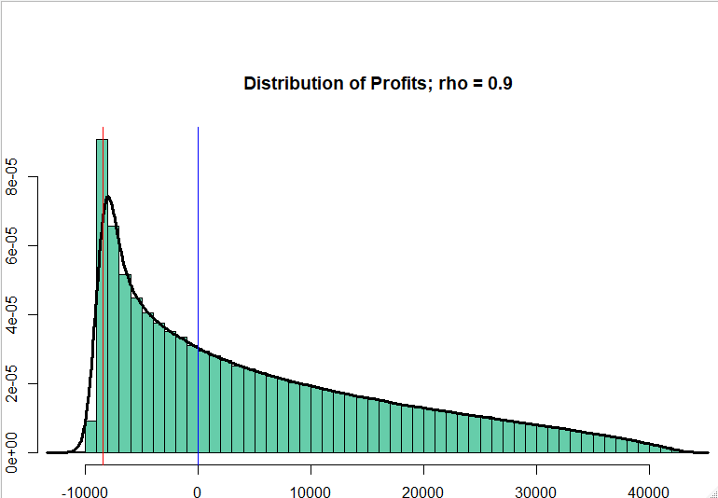
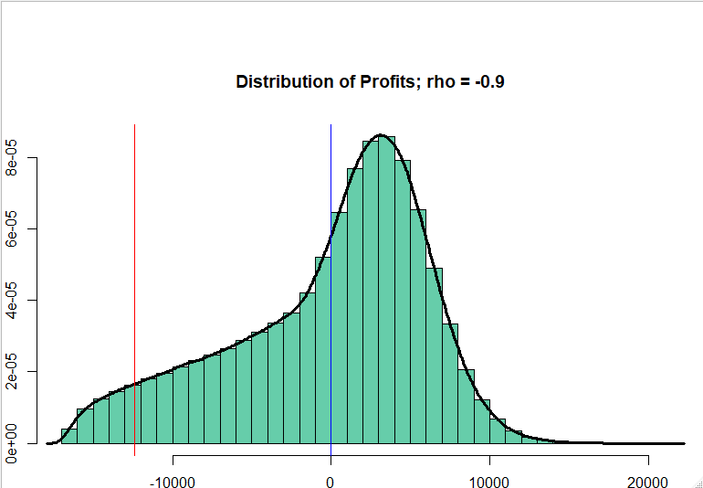
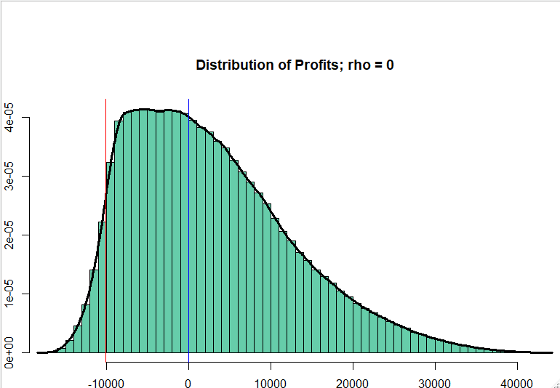
More practical example: risk estimation of business (continuations)
Negative correlation
Positive correlation
What is good for our firm? It depends on what we want to maximize/minimize (profit/risk) ..... the problem will be continued on risk and uncertainty lecture. You should know how to use the moment statistics - classical (mean, sd), positional measures (median, quartiles, VaR) and stochastic dominance to estimate/compare the profitability and risk of the venture.
No correlation

Slide 25
More practical example: risk estimation of business (continuations on exam)
AI investments are very risky, especially since we do not have historical data to determine the time horizon in which we can expect profits and whether this is not a random pure speculation bubble similar to the dot.com craze. In your exam task, you must analyze the profitability of AI investments in an "unspecified" company. I will outline some framework in the task, but you can already think about how to do it, and you do not have to stick to my suggestions. You can also use other tools from today's lecture and, of course, from financial mathematics.
It would help if you used the classical/moment statistics - (mean, sd), positional measures (median, quartiles, VaR) and stochastic dominance to estimate/compare the profitability and risk of the venture. Use: my codes and master thesis by Bartosz Głowacki, see chapters 3 and 4 ( the new version of the MC from the thesis was used to apply for a grant to finance the venture - with success)

Slide 26
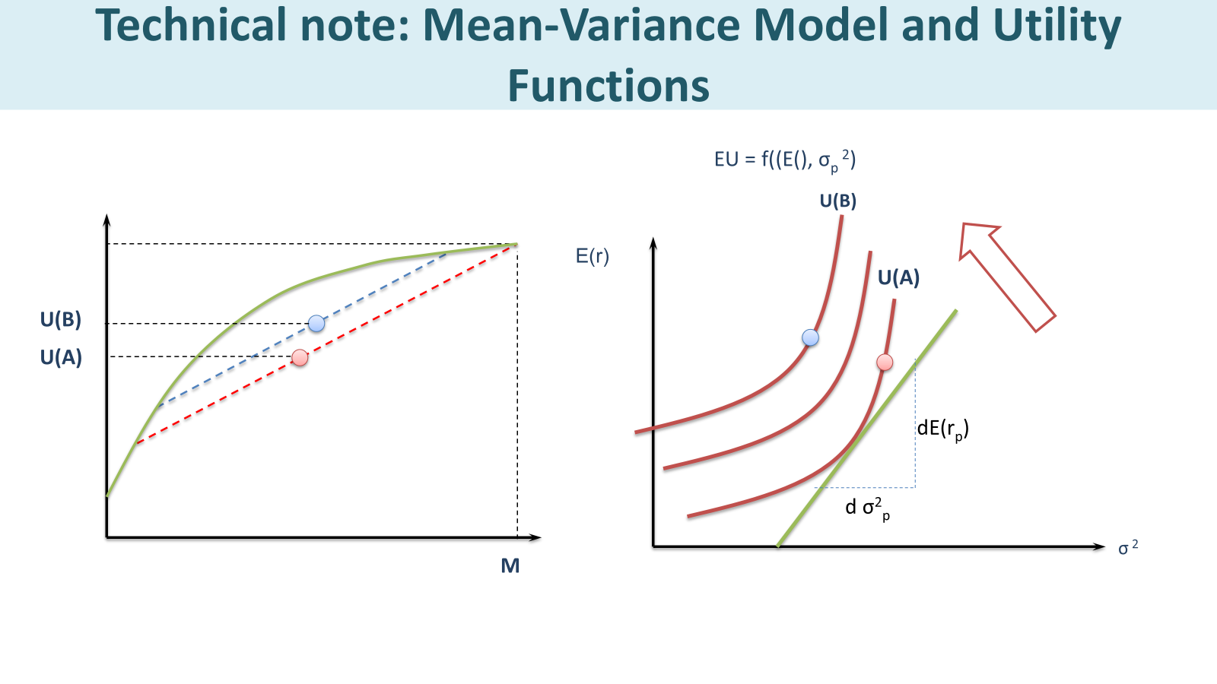
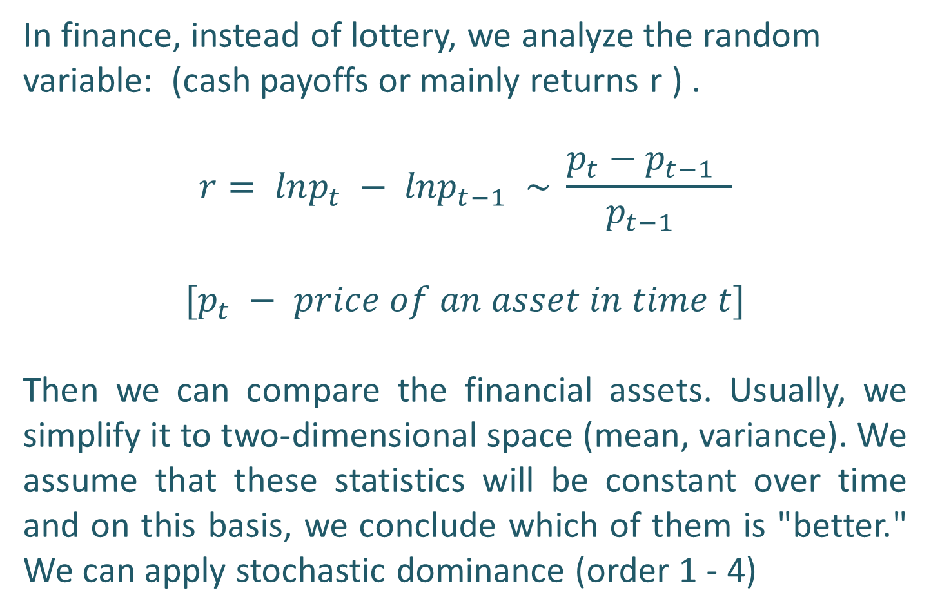
Stochastic dominance on order 1 - 4
In finance, instead of lottery, we analyze the random variable: (cash payoffs or mainly returns r ) .
$$r= lnp_{t} − {lnp}_{t−1 }\sim \frac{p_{t}−p_{t−1 }}{p_{t−1 }}$$
$$[p_{t} − price of an asset in time t]$$
Then we can compare the financial assets. Usually, we simplify it to two-dimensional space (mean, variance). We assume that these statistics will be constant over time and on this basis, we conclude which of them is "better." We can apply stochastic dominance (order 1 - 4)

Slide 27
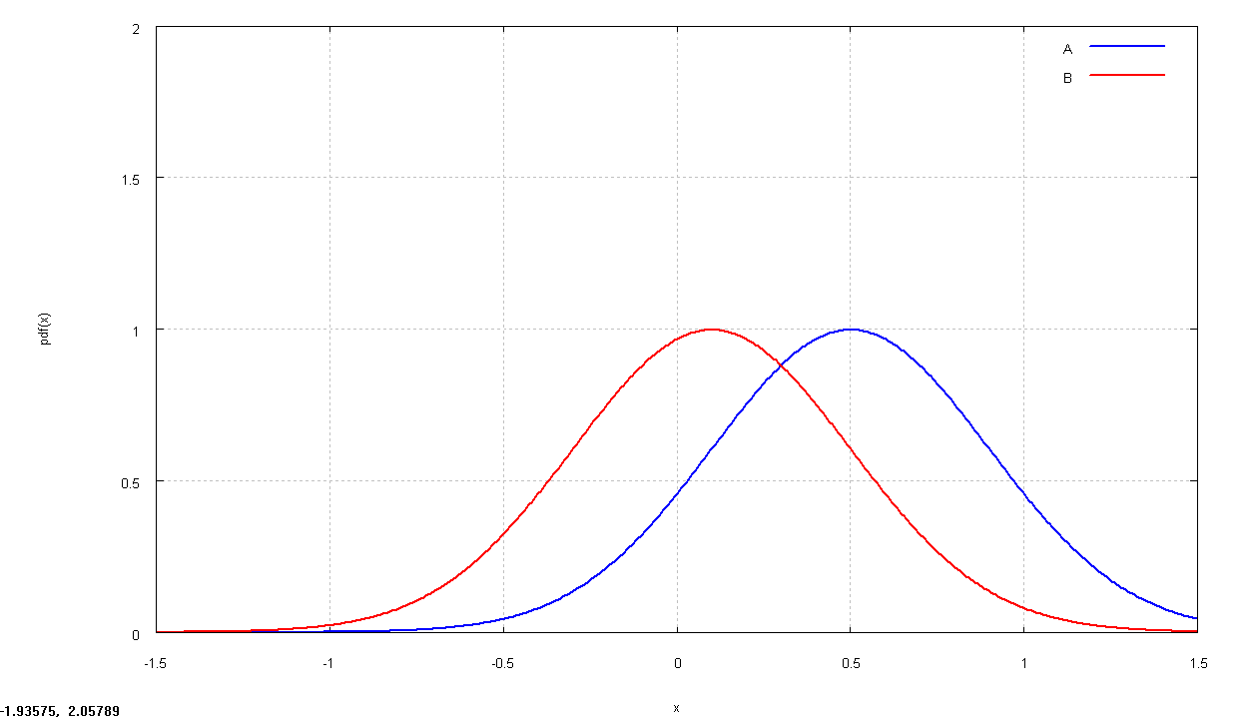
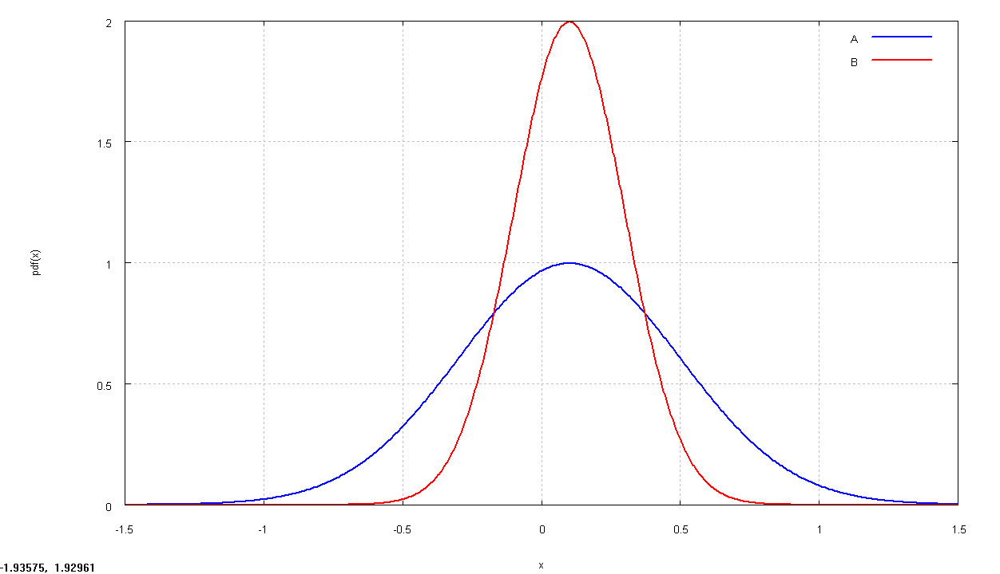
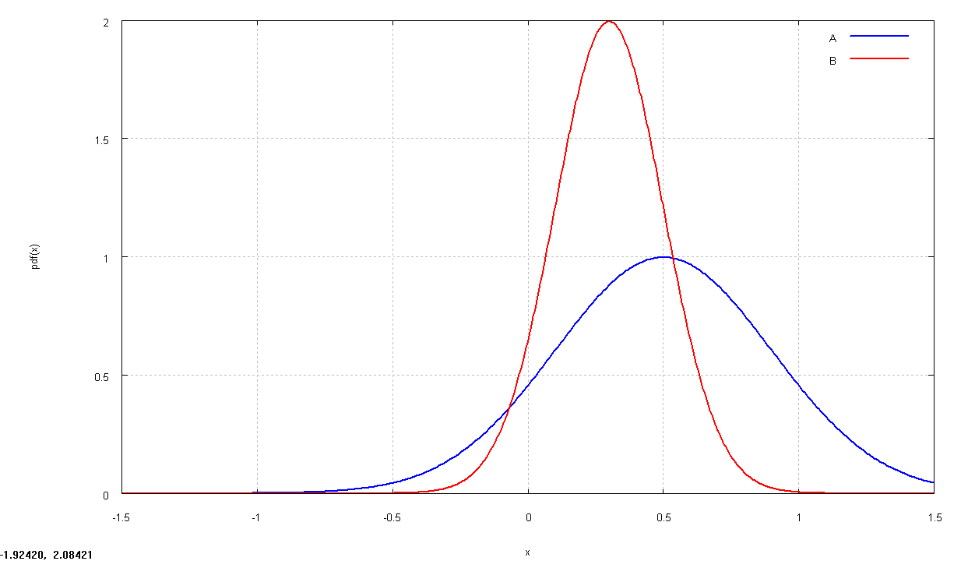
Stochastic dominance on order 1, 2
a ≻ b
μ (r_{a} ) > μ (r_{b} ) and sd_{a} = sd_{b}
μ(r)
a
The First Order Stochastic Dominance
Let F_{a}(x) and F_{b}(x) respectively represent the cumulative distribution functions of two random variables (cash payoffs, returns) that, without loss of generality assume values in the interval [k,l]. We say that F_{a}(x) first order stochastically dominates F_{b}(x) if and only if for all x ∈ [k,l] F_{a}(x) ≤ F_{b}(x)
b
sd
μ(r)
The Second Order Stochastic Dominance
( we have to assume risk avers person)
a
b
a ≻ b
μ (r_{a} ) = μ (r_{b} ) and sd_{a} < sd_{b}
sd
We can not decided based on the First and Second Order Stochastic Dominance. We have inconsistent results.
μ(r)
a
b
a ??? b
μ (r_{a} ) > μ (r_{b} ) and sd_{a} > sd_{b}
sd

Slide 28
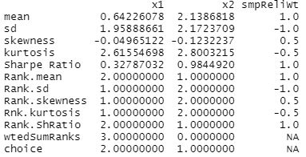
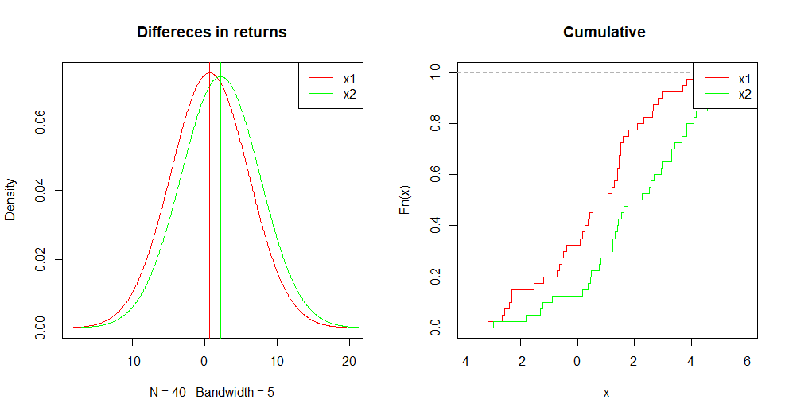
Stochastic dominance on order 1 - 4
Usually, in finance, we rarely use a formal definition (except the First Order Stochastic Dominance). Instead, we calculate statistics, give them weights and create a sort of ranking [see generalCorr package description and → file stochastic_dominance.R]
# Case 1
x1 <- 2*rnorm(40)
x2 <- x1 + 3*runif(40)
decileVote(cbind(x1,x2))
momentVote(cbind(x1,x2))

Slide 29
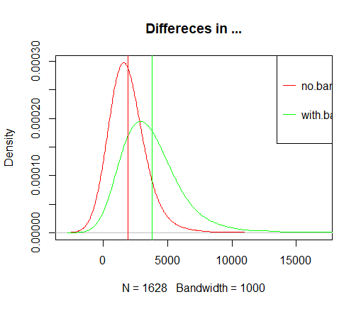
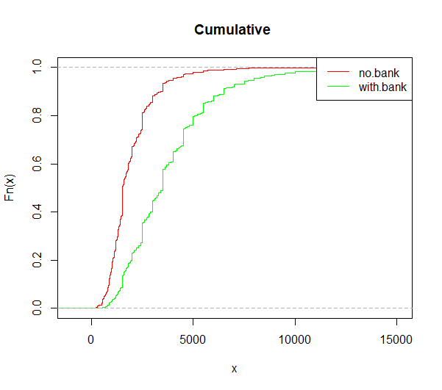
How to apply the first-order stochastic dominance to measure inequality (bank.acount.R)
Problem: Do households that use banking services have significantly higher incomes than households that do not use banking services? You can use the t-test or the non-parametric Kologomorov-Smirnoff test. (Are the samples from the same distribution?)
H0: The difference in the means is 0 ( t-test)
H0: The samples are from the same distribution.
H1: CDF Income.no.bank.account
lies above CDF Income.with.bank.account
(K-S test)
Additional inspiration – explore if you feel like it!
t.test(Income.no.bank.account,Income.with.bank.account, alternative = "less" )
ks.test(Income.no.bank.account,Income.with.bank.account, alternative = "greater" )
Welch Two Sample t-test
t = -48.44, df = 4633.4, p-value < 2.2e-16
alternative hypothesis: true difference in means is less than 0
mean of x mean of y
1910.302 3814.441
Two-sample Kolmogorov-Smirnov test
D^+ = 0.46972, p-value < 2.2e-16
alternative hypothesis: the CDF of x lies above that of y

Slide 30
Value at Risk part 2
VaR (Value at Risk) determines the value of the loss of assets/liabilities with the adopted tolerance level (usually 5%), in given market conditions, over a specified period of time. The idea: ignoring the 5% least probable results, how much can we lose maximally in a given time horizon (what is the worst scenario) This is a different definition of risk based on position measure - usually it is the fifth percentile of the distribution of a random variable (cash payoffs, returns, ... )
CASE
You bought a flat for PLN 0.54 million; based on historical data, you can determine how much the price increases monthly and the volatility of this change. You want to sell this flat in 12 or 24 months. You want to determine the VaR (5%) of this investment for 12 and 24 months - that is, what the lowest price of the flat can be (ignoring the 5% of the least probable results) - how much you can lose on flipping.

Slide 31
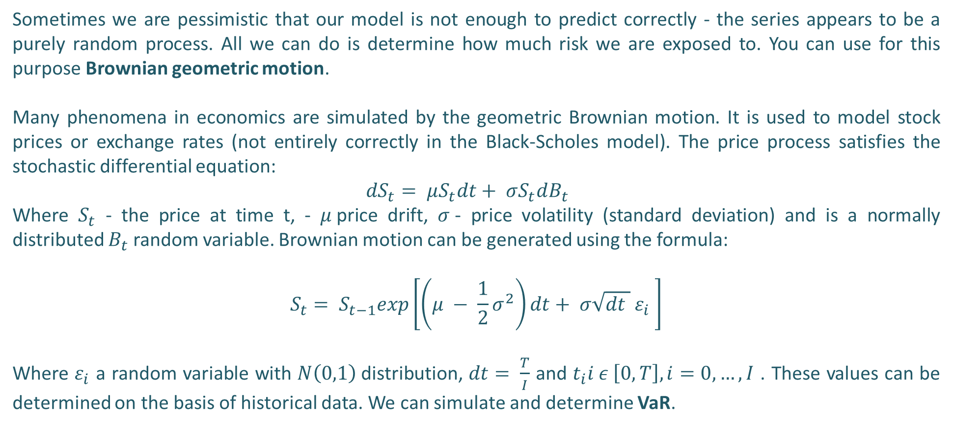
Value at Risk
Sometimes we are pessimistic that our model is not enough to predict correctly - the series appears to be a purely random process. All we can do is determine how much risk we are exposed to. You can use for this purpose Brownian geometric motion.
Many phenomena in economics are simulated by the geometric Brownian motion. It is used to model stock prices or exchange rates (not entirely correctly in the Black-Scholes model). The price process satisfies the stochastic differential equation:
${dS}_{t}= μS_{t}dt+ σS_{t}dB_{t}$
Where $S_{t}$ - the price at time t, - $μ$price drift, $σ$- price volatility (standard deviation) and is a normally distributed $B_{t}$ random variable. Brownian motion can be generated using the formula:
$$S_{t}= S_{t−1}exp\left[\left(μ − \frac{1}{2}σ^{2}\right)dt+ σ\sqrt{dt } ε_{i} \right]$$
Where $ε_{i}$ a random variable with $N\left(0,1\right)$distribution, $dt= \frac{T}{I}$ and $t_{i}i ε \left[0,T\right], i=0,…,I$ . These values can be determined on the basis of historical data. We can simulate and determine VaR.

Slide 32
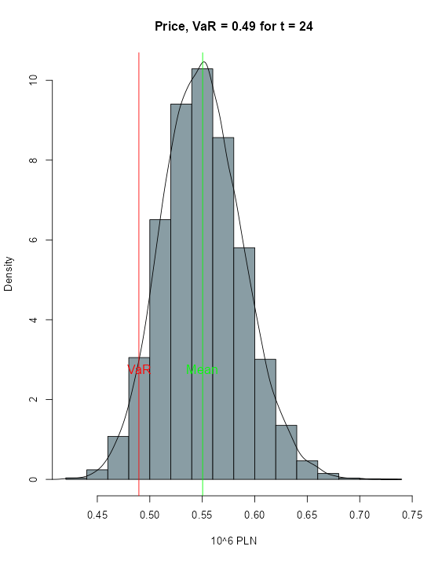
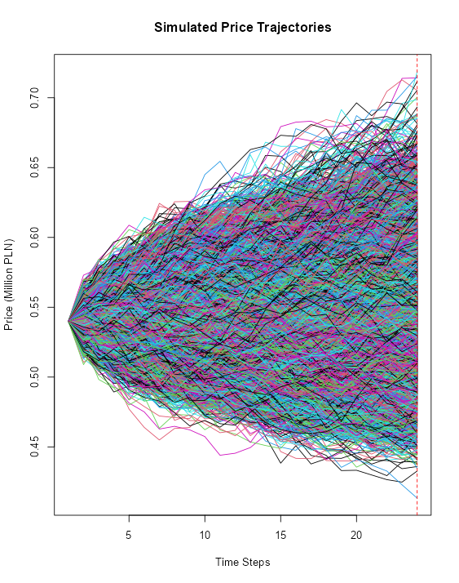
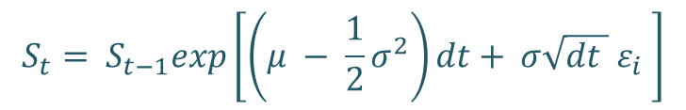
Value at Risk
$$S_{t}= S_{t−1}exp\left[\left(μ − \frac{1}{2}σ^{2}\right)dt+ σ\sqrt{dt } ε_{i} \right]$$
Old data → parameters

Slide 33
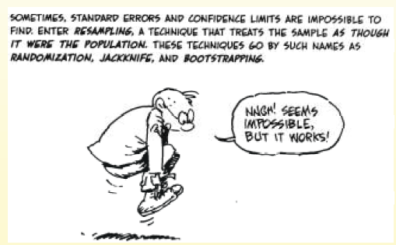
Bootstrapping
When the data set(sample) is small, you can use a statistical technique which gives you a much better approximation of the population properties than the sample estimators. The magical techniques is bootstrap/bootstrapping.
The technique - is based on resampling of the sample. It's like the adventures of Baron Munchausen, who pulled himself and the horse he is sitting on out of a swamp by his own hair.
I will present you bootstrapping and it will be the beginning of your home task. The old version of the explanation is at the end of the slides (not presented at the lecture).

Slide 34
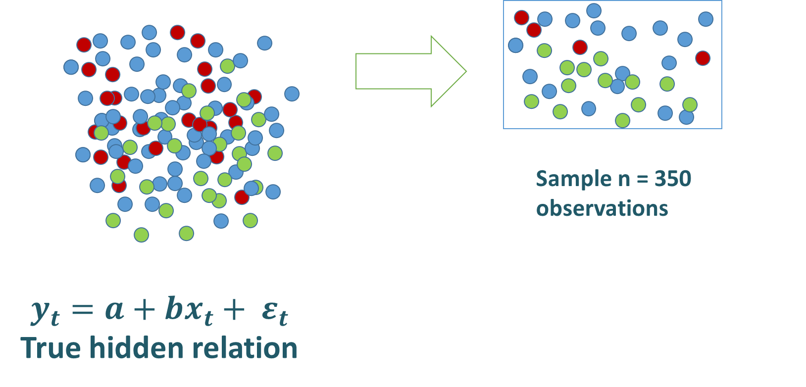
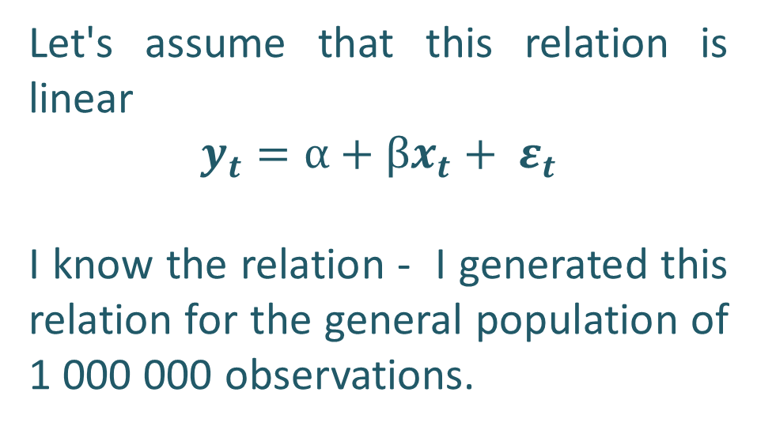
Bootstrapping
The nature created a relationship between two variables x and y. The true relationship between the variables is hidden from you because there is some randomness and you have only sample data of the population.
Let's assume that this relation is linear
$$y_{t}=α+βx_{t}+ ε_{t}$$
I know the relation - I generated this relation for the general population of 1 000 000 observations.

Slide 35
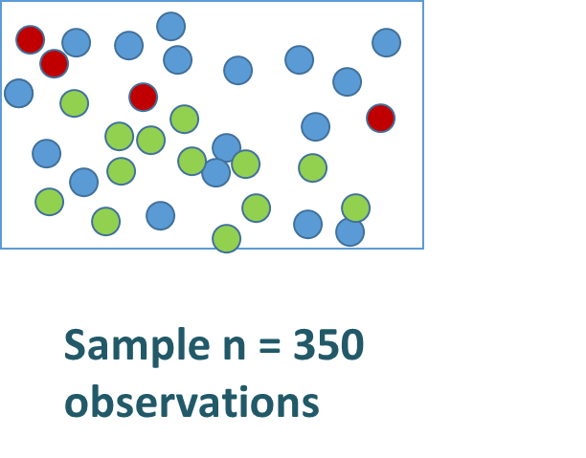
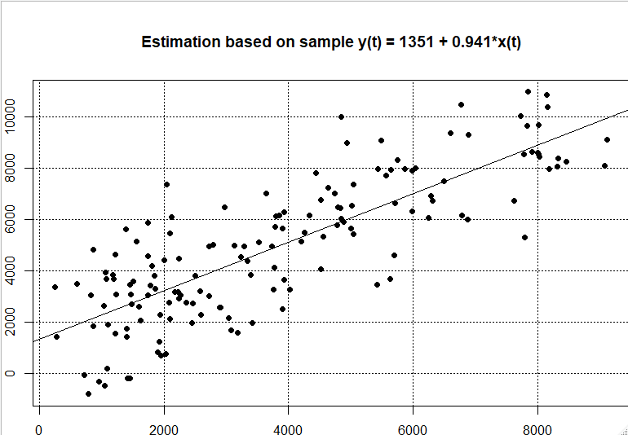
Bootstrapping
I give you a sample of the population (350 observations) your task will find the true relations [a, b]. (See Bootstrap 2023 Student.R)
But this sample seems too small to determine the true relationship. We can estimate the OLS model, but how can we be sure of the results which are estimated on such a small sample.
We can reproduce the sample by bootstrapping.

Slide 36
Bootstrapping
We have the original sample of n observations.
1 )We draw with replacement a new bootstrap sample from the orginal sample. The number of observations in the bootstrap sample is n.
2) For the bootstrap sample, we estimate an OLS model and obtain estimates a and b. We save the estimates.
3) Replicate B times (1 000 000) the procedures (1 and 2) obtaining B bootstrap estimates of a and b.
We can construct the distribution of the bootstrap estimates. Based on the distribution we can make statistical inference about the true value of α and β. We can calculate mean, standard error and confidence interval for the bootstrap estimates.

Slide 37
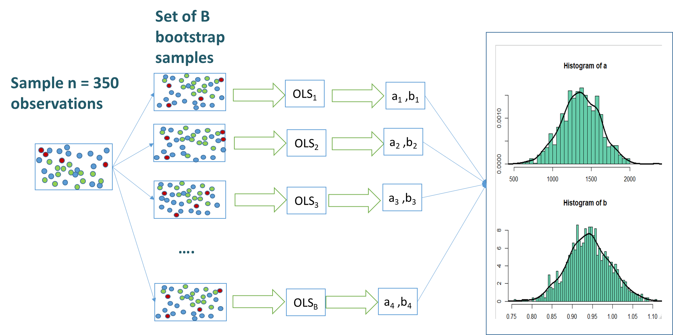
Bootstrapping
The population is to the sample as the sample is to the bootstrap samples

Slide 38
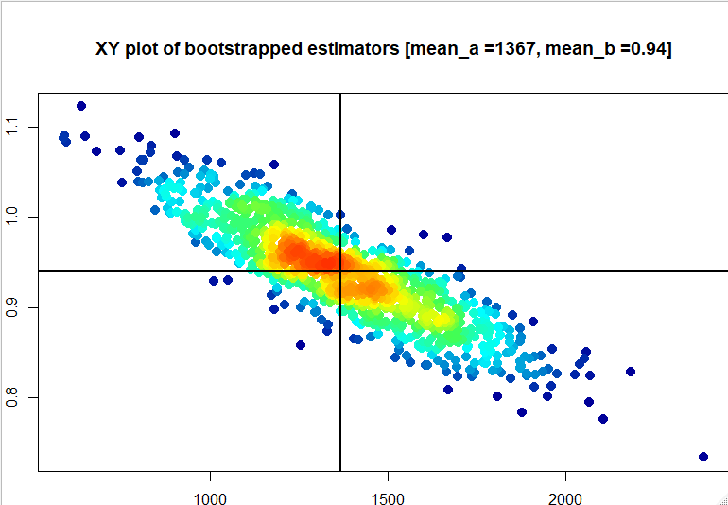
Bootstrapping - topic contest/task
The means of the [a, b] estimates are not the best approximation of true parameters [α, β]. The estimated parameters are dependent.
Your goal is to find a pair of [a, b] which is the best approximation of unknown [α, β] the most representative set of parameters. For the best estimation [criterium: minimization of squared forecast error for the whole population] he/she will receive 10$FBEE. All the posts will be graded 5$
You can use codes from Bootstrap 2024 Student.R and use difent bootstrap procedures (I used the naive bootstrap) using boot R package, ..., you can use unsupervised learning techniques K-means and PAM.

Slide 39
Bootstrapping on our lectures
We will use the bootstrap method to your data from experiments - our lectures. We enter the data to theoretical models and we will find the area of possible equilibrium, not ending on a point estimation.
The bootstrap can be used to improve the robustness of your forecast.
https://www.analyticsvidhya.com/blog/2020/02/what-is-bootstrap-sampling-in-statistics-and-machine-learning/
https://towardsdatascience.com/an-introduction-to-the-bootstrap-method-58bcb51b4d60

Slide 40
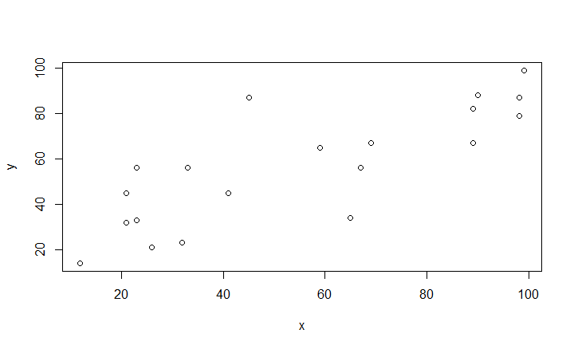
Bootstrapping - the old explanantion
„The bootstrap method is a resampling technique used to estimate statistics on a population by sampling a dataset with replacement”
Modification of the original example (Efron 1979): We have dataset: the results of the microeconomic exam (x_{i}) and the mathematical exam (y_{i}) obtained by 20 WNE students.
As you can easily notice, there is a positive relationship between variables. This is confirmed by the value of Pearson correlation coefficient calculated for observations corr(x, y) = 0.8035187 This is a sample and we do not know how this coefficient is observed for the whole population, we want to find the ranges in which this coefficient is found, i.e. estimate the standard deviation of this coefficient .
Additional inspiration – explore if you feel like it!
x y
x 1.0000000 0.8035187
y 0.8035187 1.0000000

Slide 41
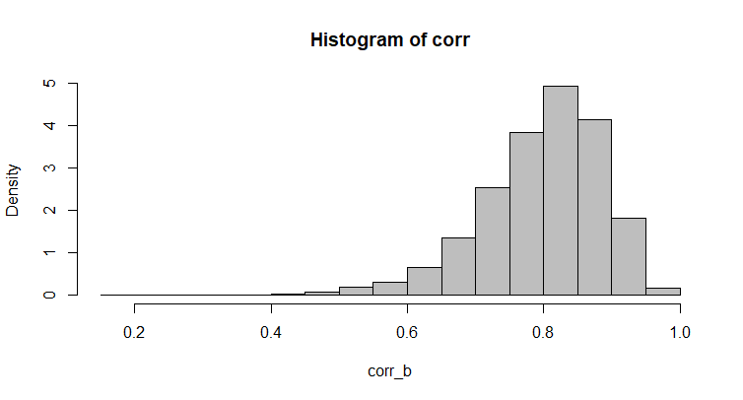
Bootstrapping - - the old explanantion
We have 19 observations, each of them consists of pairs (x_{i}, y_{i}) = z_{i}. We can bootstrap this sample (z^{b}₁, z^{b}₂, ....., z^{b}₂₀), i.e. by random selection of z_{i} from orginal data set (drawing with replacement). For this new sample we count the correlation coefficient and repeat the whole procedure B times. We obtain the empirical distribution of correlation coefficients and we can estimate the value of the estimator of variance or other statistics.
The results of our procedure are:
  Empirical density distribution --> a histogram
  Basic statistics of the distribution of the bootstrap correlation coefficients
Additional inspiration – explore if you feel like it!
Min. 1st Qu. Median Mean 3rd Qu. Max. sd
0.2037 0.7486 0.8126 0.7994 0.8629 0.9904 0.08796197

Slide 42
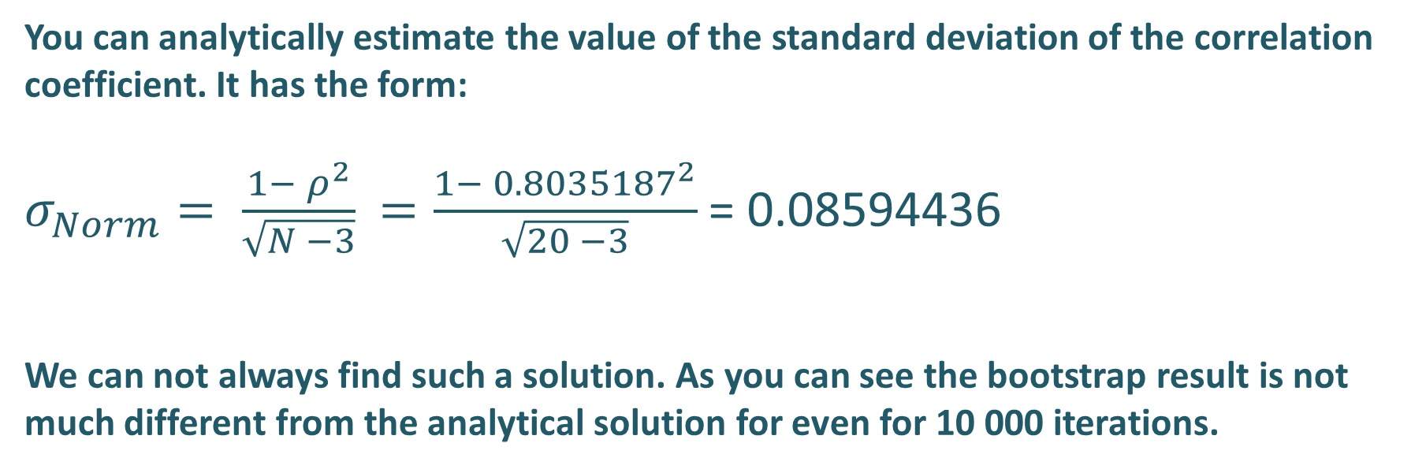
Bootstrapping - the old explanantion
You can analytically estimate the value of the standard deviation of the correlation coefficient. It has the form:
$σ_{Norm}= \frac{1− ρ^{2}}{\sqrt{N −3}}$ $=\frac{1− {0.8035187}^{2}}{\sqrt{20 −3}}$ = 0.08594436
We can not always find such a solution. As you can see the bootstrap result is not much different from the analytical solution for even for 10 000 iterations.
Additional inspiration – explore if you feel like it!
Min. 1st Qu. Median Mean 3rd Qu. Max. sd
0.2037 0.7486 0.8126 0.7994 0.8629 0.9904 0.08796197

